Slide 1


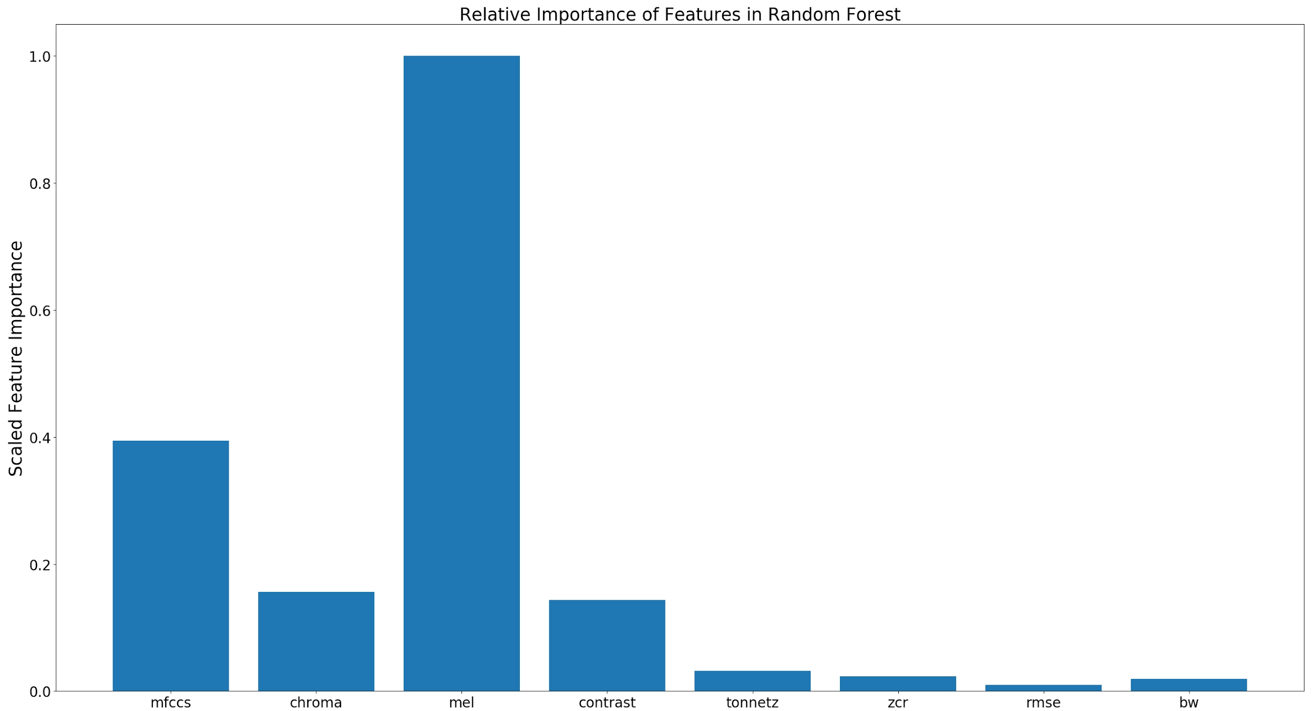
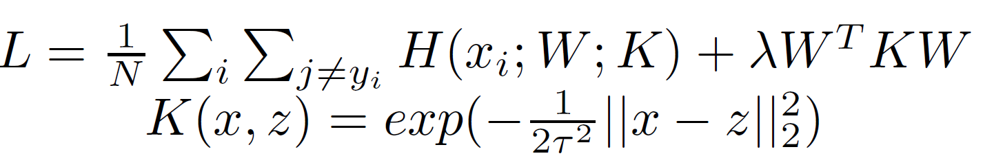
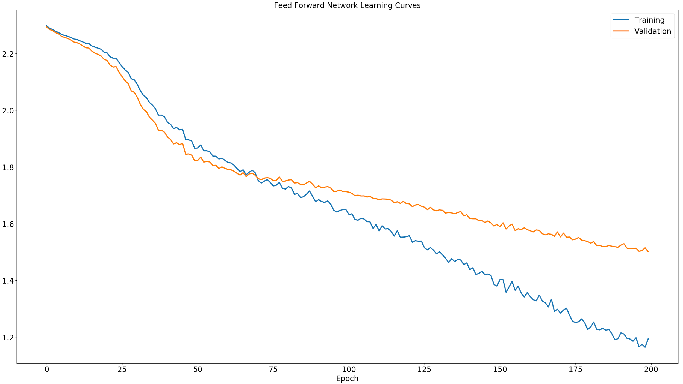
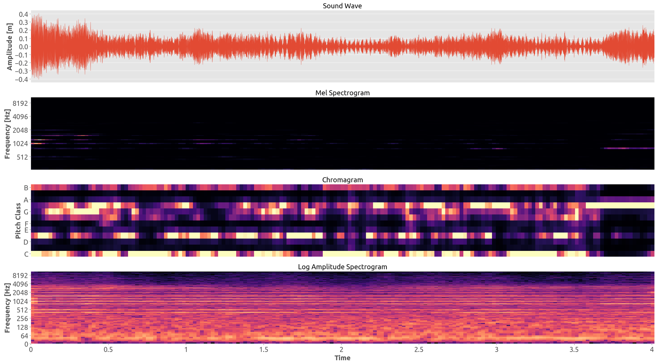
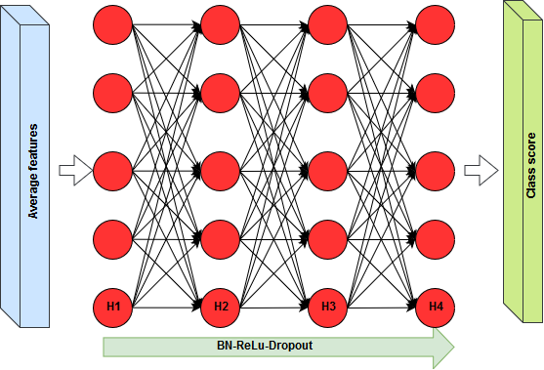
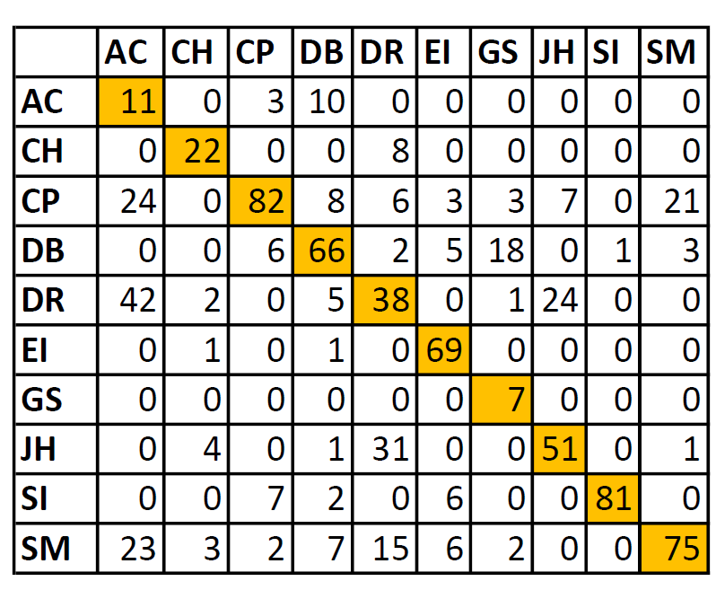
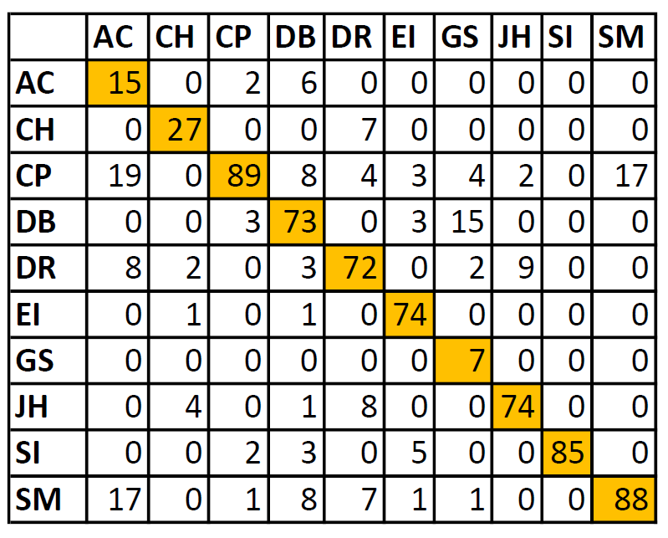
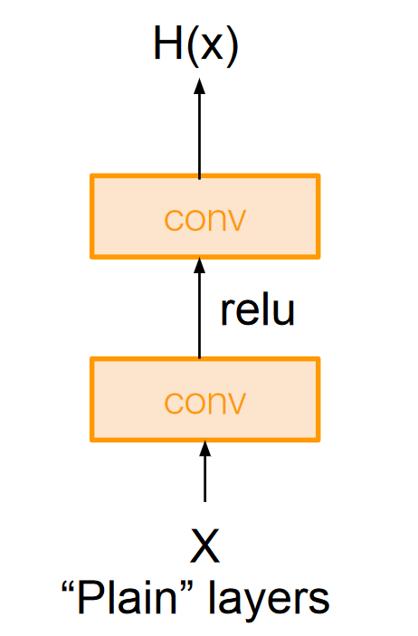
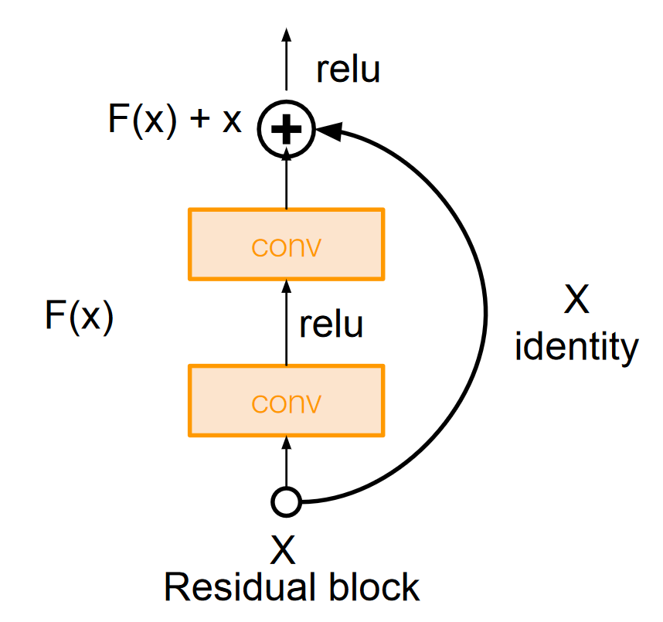
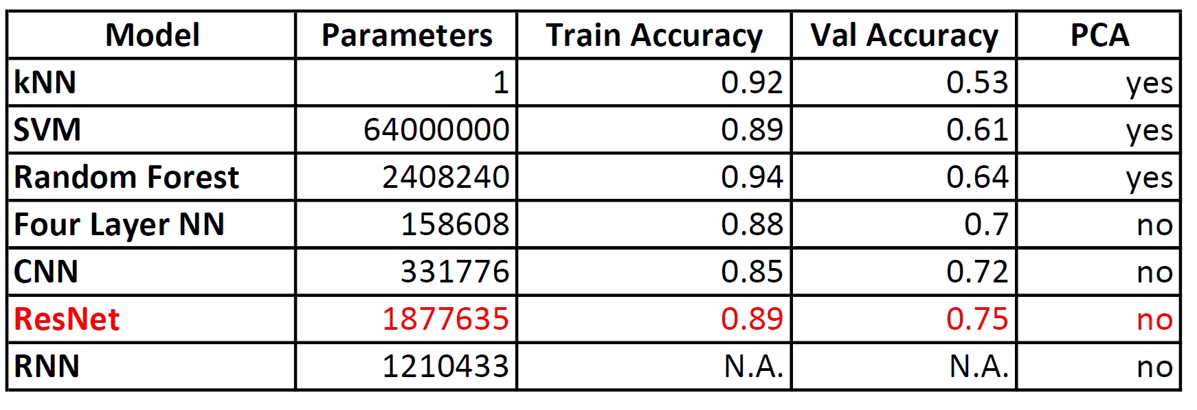
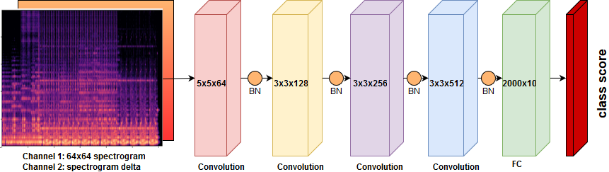
A Survey of Sound Classification Using Classic Methods and Deep Learning
Filippo Ranalli and Hiroshi Mendoza
[franalli; hmendoza]@stanford.edu
CS221 - Fall 2017 - Stanford University
Objective
Classic Architectures
Results
Approximately 5% of the world population is afflicted by
a form of hearing loss, which can lead to difficulties in identifying nearby dangers or meaningful occurrences around them. Such problem motivates research aimed at building systems that can recognize surrounding sounds in real time, and provide rapid feedback to the user. In this project we attempt to tackle sound recognition by analyzing predictive models, using shallow and deep AI techniques to classify environmental and urban sound sources. It is within our goals to analyze their performance, comparing their advantages and shortcomings.
KNN
kNN classifies an example by majority vote of the K closest data point labels in the training set, using the L2 norm as the distance measure.
SVM
A support vector machine (SVM) is a classifier that uses a hinge loss and can use a nonlinear kernel to transform the feature domain for improved separability. The loss function and the kernel are described by the following equations:
Random Forest
The Random Forest classifier is an ensemble method based on majority voting of decision tree modules. In such model, all observed information is encoded in the edges, and all predictions in the leaves.
Setup
Librosa: Amplitude-frequency conversion, feature extraction
Sklearn: Metrics, kNN, SVM, Random Forest
Pytorch CPU: Feed-Forward Neural Network
Pytorch GPU: CNN baseline, ResNet, RNN
Deep Architectures
Dataset
4-Layer NN
ResNet
The ResNet architecture adopted is an 18 layer CNN with increasing filter depth, batch normalization and residuals every two layers
4-Layer NN Confusion Matrix
ResNet Confusion Matrix
UrbanSound8K: 8732 labeled and evenly distributed data points from 10 different classes: air conditioner (AC), car horn (CH), children playing (CP), dog bark (DB), drilling (DR), engine idling (EI), gunshot (GS), jackhammer (JH), siren (SI), and street music (SM). Each example is a 4 second .wav file. The set is divided into train, dev and test.
CNN
The baseline CNN features four layers of increasing filter depth, batch normalization on every layer and dropout on the final fully connected layer.
Conclusion
Shallow methods are a function of the dataset size and tend to heavily overfit. On the upside they are quick to train and provide significant insight for feature selection.
The fully connected neural network is a step-up compared to shallow methods, but tends to overfit.
CNN and ResNet are significantly more expressive and extract features directly on the spectrogram, achieving higher performance.
The LSTM-RNN will capture sequential time-frequency relations.
References
CS231n/CS221 Lecture Slides.
He, Zhang, Ren, Sun, “Deep Residual Learning for Image Recognition”.
UrbanSound8K;https://serv.cusp.nyu.edu/projects/urbansounddataset/urbansound8k.html.
J. Salamon, C. Jacoby, and J. P. Bello. A dataset and taxonomy for urban sound research.

